Slide 1
Arabic Cyberbullying Detection Using Arabic Sentiment Analysis Samar Almutiry^{*1}, Mohamed Abdel Fattah^{**2} *College Of Computer Science And Engineering, Taibah University Saudi Arabia- Almadinah Almunawarah **Department Of Electronics Technology, FIE, Helwan University, Cairo, Egypt
Prepared by: Nisreen El-Khansa
Dr. Alaf Makke

Slide 2
Objectives
To categorize Arabic tweets into CyberBullying and Non-CyberBullying.
To create the automatic dataset, mark the tweets manually and automatically, and keep the corpus public available in order to aid the research community.
To create different “Arabic Dialects Stop Words” and “Modern Standard Arabic” (MSA) list from our gathered dataset.
To create a list of “Arabic CyberBullying” words from our gathered dataset.
To apply a standard Machine Learning classifier (SVM) on our dataset.
To create our model by the use of Python and WEKA, and comparison of the obtained results.

Slide 3
Research Questions
Q1: What are the challenges and how to resolve them for the processing of the Arabic language?
Q2: How can different preprocessing steps affect the classification accuracy of the model?
Q3: Which data mining tool provides better results?
Q4: Which data mining tools are more efficient with time for model classification?

Slide 4
Outline
1. Introduction:
- Introduces the research on Arabic CyberBullying detection using Sentiment Analysis (SA) and Machine Learning (ML).
- Highlights the importance of Natural Language Processing (NLP) and Text Classification (TC), specifically Sentiment Analysis, in understanding human language.
- Emphasizes the challenges of applying SA to the Arabic language, including complex morphology and a lack of research in the field.
2. Literature Review:
- Reviews existing literature on sentiment analysis, text classification, and CyberBullying detection, focusing on English language studies.
- Identifies a research gap in applying SA to the Arabic language.
- Discusses previous approaches, tools, and challenges related to sentiment analysis in Arabic text.

Slide 5
3. Methodology:
- Describes a four-step methodology:
- Data collection using ArabiTools and Twitter API, including random and query-oriented methods.
- Annotation of collected data with Arabic CyberBullying words.
- Data preprocessing, including cleaning, normalization, removal of stop words, stemming, and tokenization.
- Data classification using Support Vector Machine (SVM) in WEKA and Python.
- Presents the structure of the methodology in a visual format.
4. Results:
- Provides results from experiments using WEKA and Python with SVM.
- Reports accuracy, precision, recall, and F1 score for each experiment.
- Compares the performance of WEKA with Light Stemmer, WEKA with ArabicStemmerKhoja, and Python.

Slide 6
5. Discussion:
- Discusses the challenges faced in Arabic CyberBullying detection, including language complexity and research gaps.
- Analyzes the effectiveness of the proposed methodology.
- Compares the performance of WEKA and Python, noting differences in accuracy and processing time.
6. Conclusion:
- Summarizes key findings and contributions.
- Emphasizes the significance of the research in addressing gaps in Arabic CyberBullying detection.
- Suggests areas for future research.

Slide 7
1. Introduction to Sentiment Analysis (SA):
- Sentiment Analysis involves analyzing text to detect opinions and classify the attitude expressed.
- Challenges arise when applying SA to Arabic due to its structural and morphological complexity, termed as "Arabic Sentiment Analysis (ASA)."
2. Approach and Tools:
- Utilizing computing advancements, the study employs Machine Learning (ML) and the Support Vector Machine (SVM) algorithm for ASA.
- Data collection is automated through ArabiTools and Twitter API.
3. Dataset Labeling for Cyberbullying Detection:
- The dataset is labeled using both automatic and manual methods to efficiently detect Cyberbullying tweets.
- Cyberbullying involves using aggressive and offensive language online to bully a person.

Slide 8
4. Pre-processing Techniques:
- Several pre-processing techniques are applied to the dataset:
- Normalization
- Tokenization
- Light Stemmer
- ArabicStemmerKhoja
- Term Frequency-Inverse Document Frequency (TF-IDF) for term weighting.
5. Supervised Algorithm (SVM) Implementation:
- SVM, a standard supervised algorithm, is employed using WEKA (a data mining tool) and Python.
- Three experiments are conducted: one with WEKA using Light Stemmer, another with WEKA using ArabicStemmerKhoja, and the final one with Python.

Slide 9
. Experimental Results:
- WEKA demonstrates higher efficiency in correctly classifying text, while Python is more effective in model building time.
- Results:
- WEKA with Light Stemmer: Efficiency - 85.49%, Time - 352.51 seconds.
- WEKA with ArabicStemmerKhoja: Efficiency - 85.38%, Time - 212.12 seconds.
- Python: Efficiency - 84.03%, Time - 142.68 seconds.

Slide 10
mailto:https://www.freecodecamp.org/news/svm-machine-learning-tutorial-what-is-the-support-vector-machine-algorithm-explained-with-code-examples/
JULY 1, 2020/#MACHINE LEARNINGSVM Machine Learning Tutorial – What is the Support Vector Machine Algorithm, Explained with Code Examples

Slide 11
What is web scraping?
Web scraping (or data scraping) is a technique used to collect content and data from the internet. This data is usually saved in a local file so that it can be manipulated and analyzed as needed. If you’ve ever copied and pasted content from a website into an Excel spreadsheet, this is essentially what web scraping is, but on a very small scale.
However, when people refer to ‘web scrapers,’ they’re usually talking about software applications. Web scraping applications (or ‘bots’) are programmed to visit websites, grab the relevant pages and extract useful information. By automating this process, these bots can extract huge amounts of data in a very short time. This has obvious benefits in the digital age, when big data—which is constantly updating and changing—plays such a prominent role. https://careerfoundry.com/en/blog/data-analytics/web-scraping-guide/

Slide 12
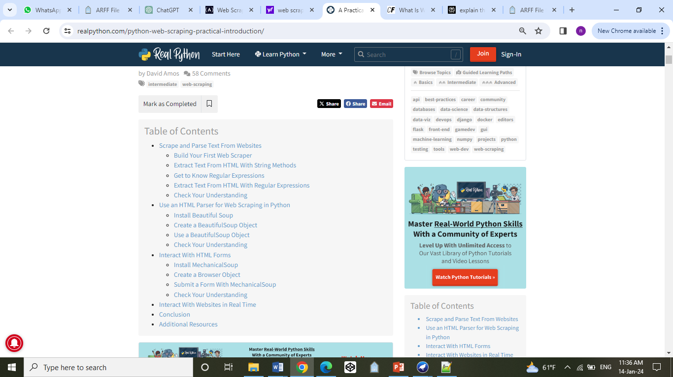
mailto:https://realpython.com/python-web-scraping-practical-introduction/

Slide 13
https://www.freecodecamp.org/news/python-web-scraping-tutorial/
JULY 12, 2022/#PYTHON
Web Scraping with Python – How to Scrape Data from Twitter using Tweepy and Snscrape

Slide 14
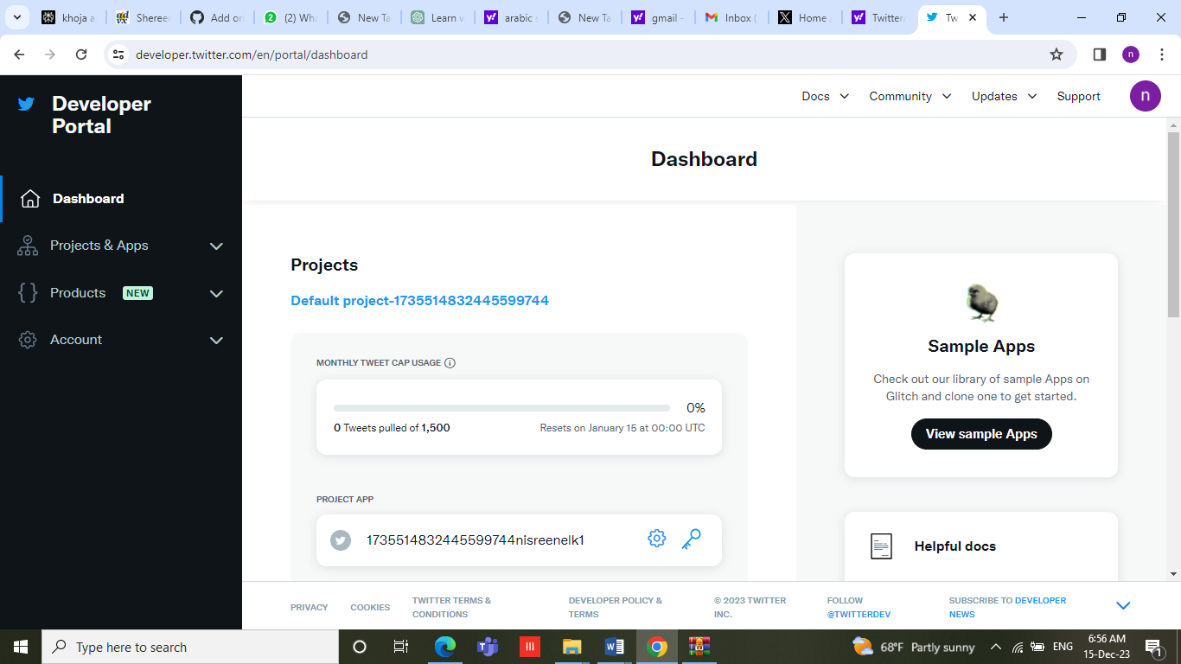

Slide 15
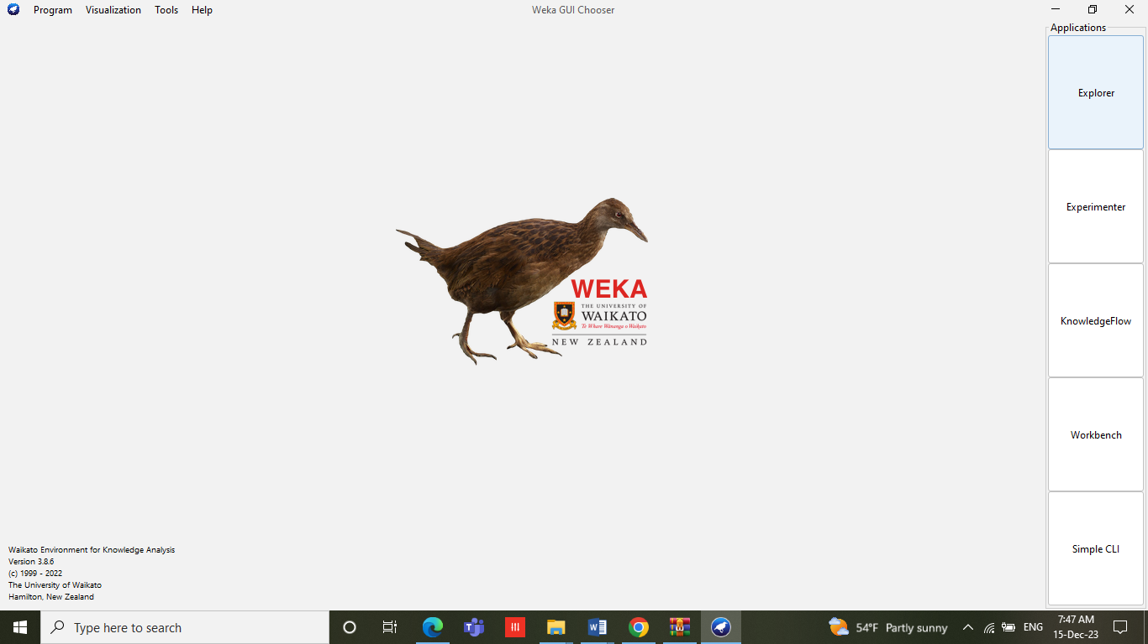

Slide 16
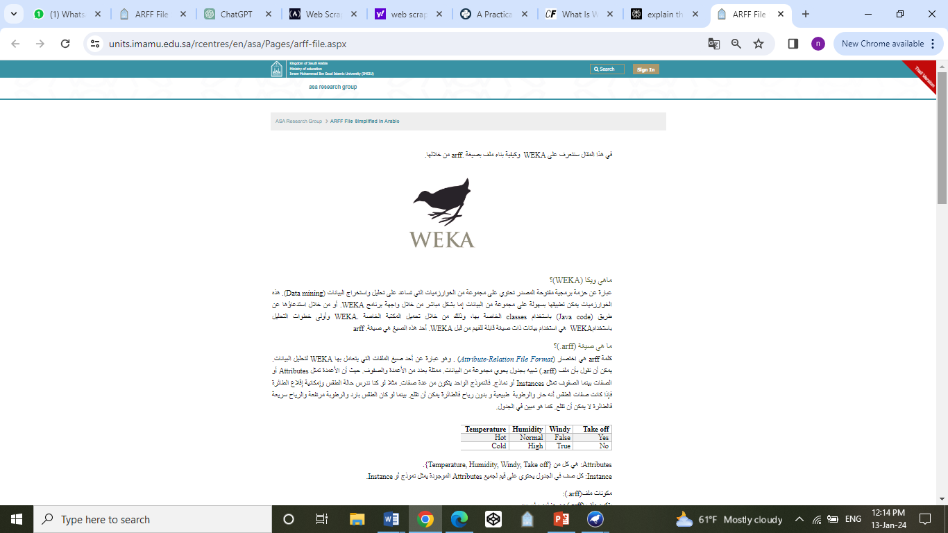

Slide 17
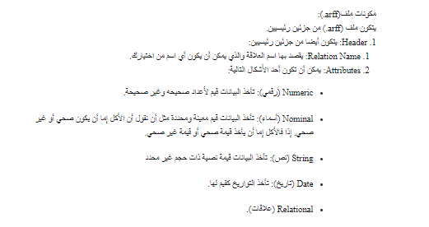

Slide 18
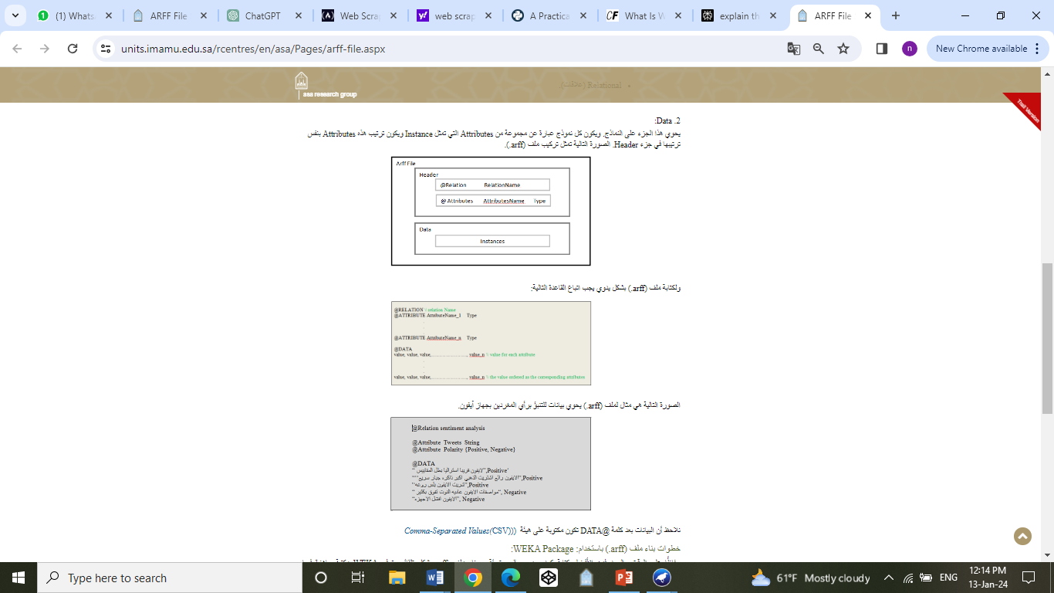

Slide 19
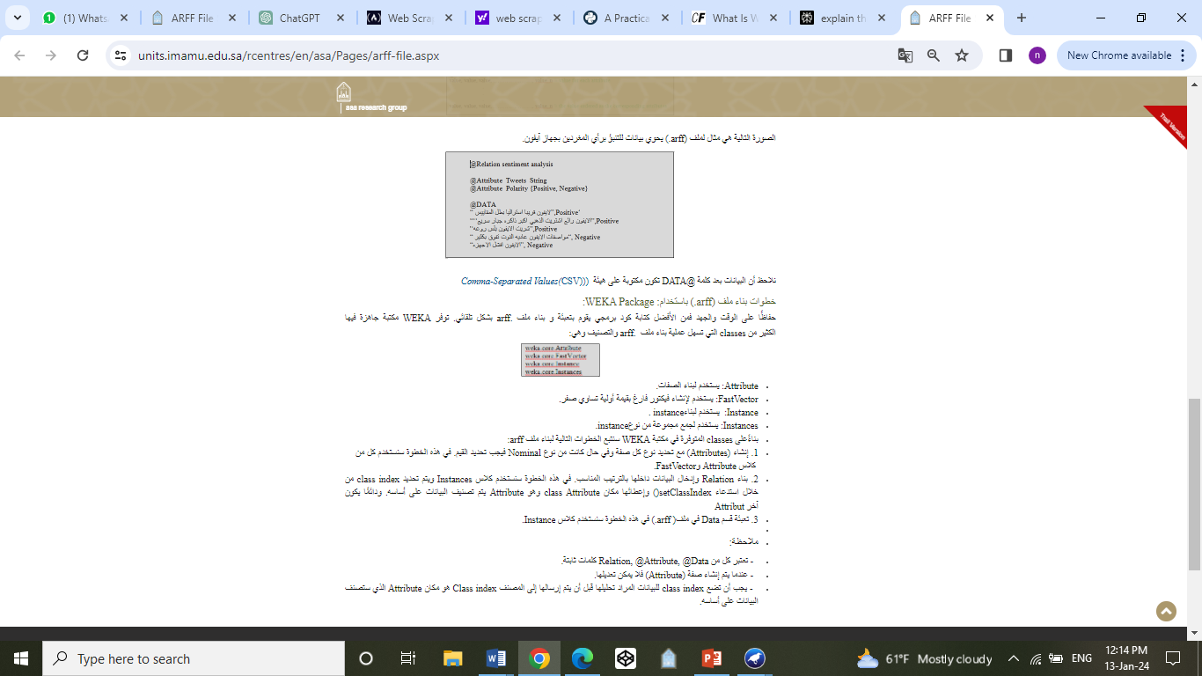

Slide 20
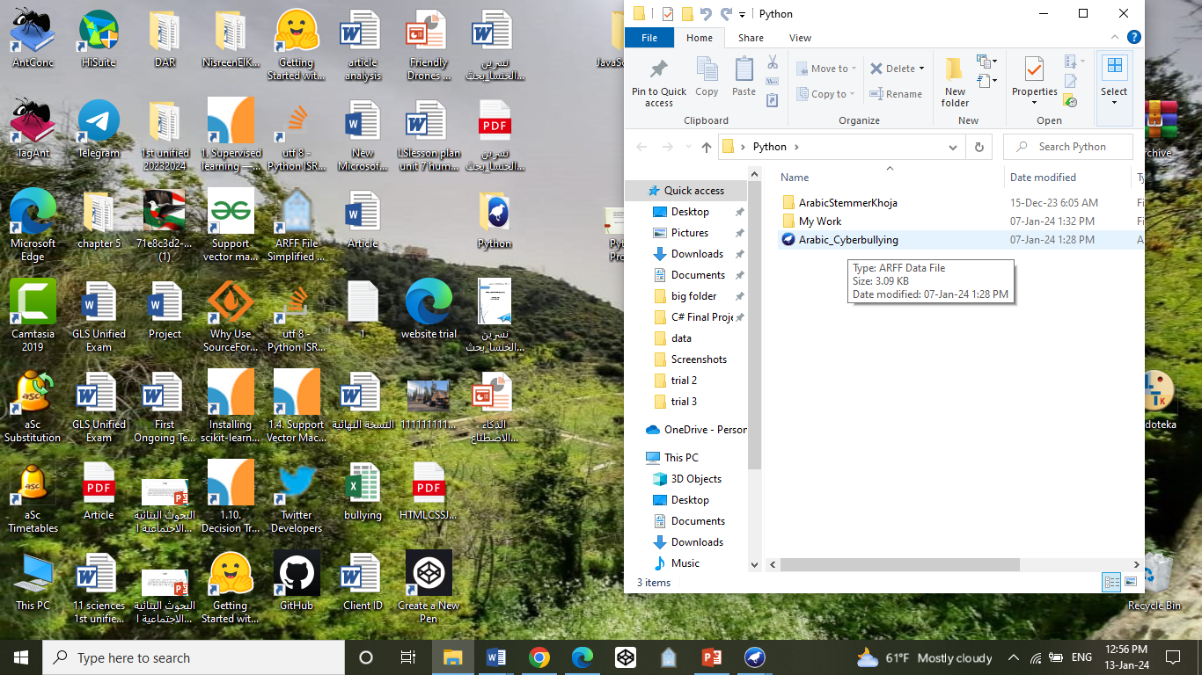

Slide 21
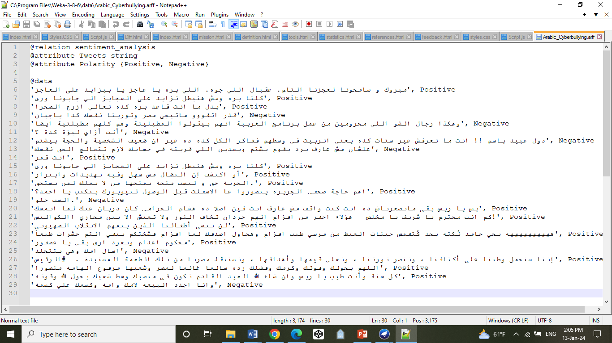

Slide 22
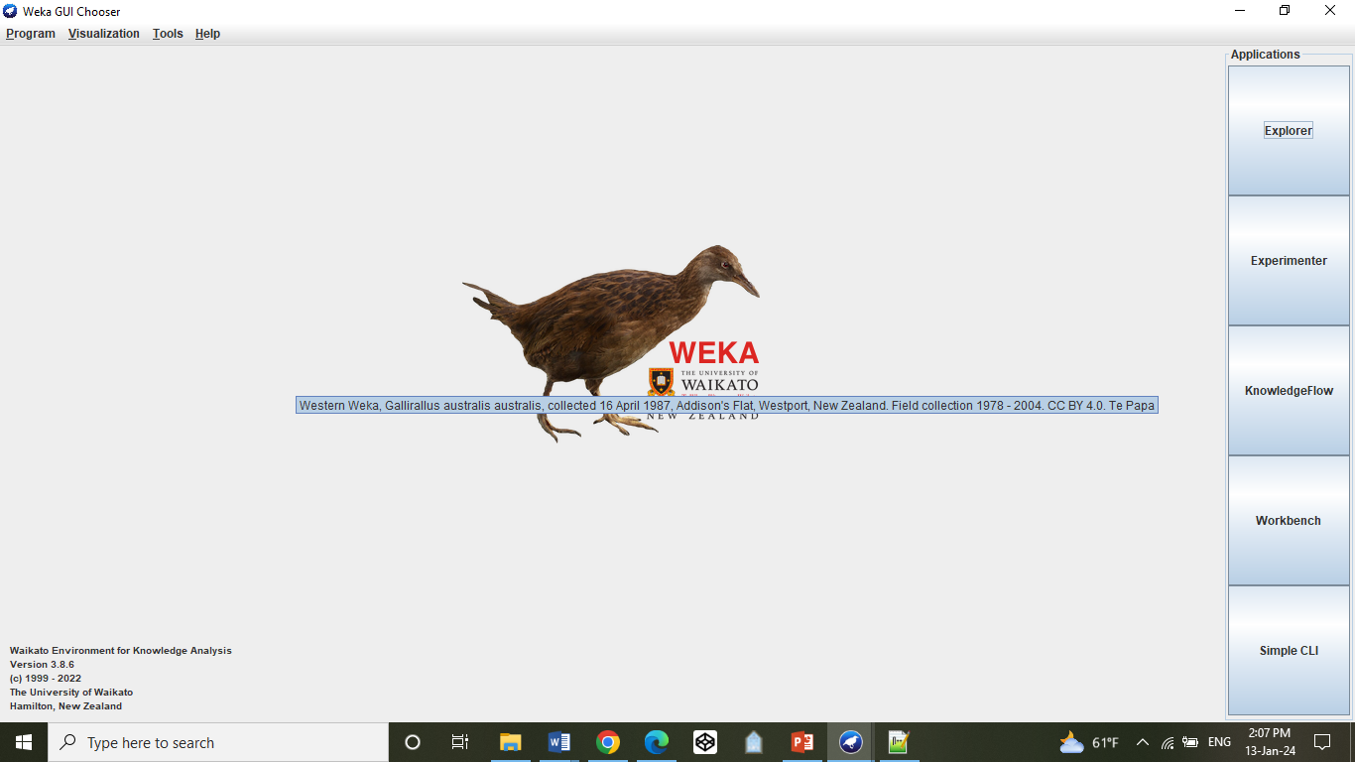

Slide 23
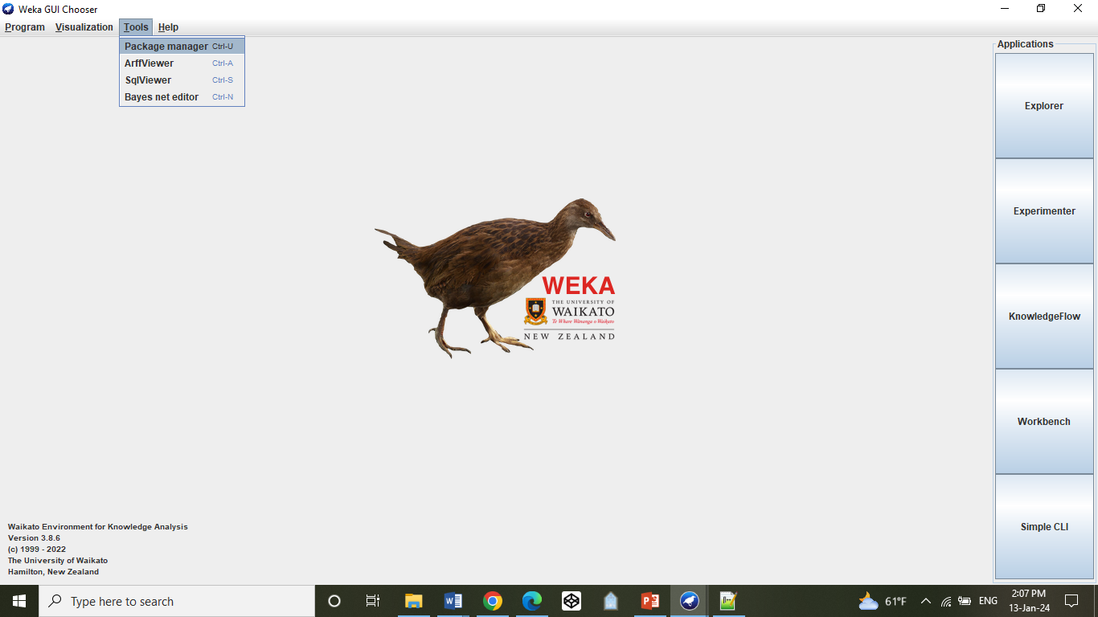

Slide 24
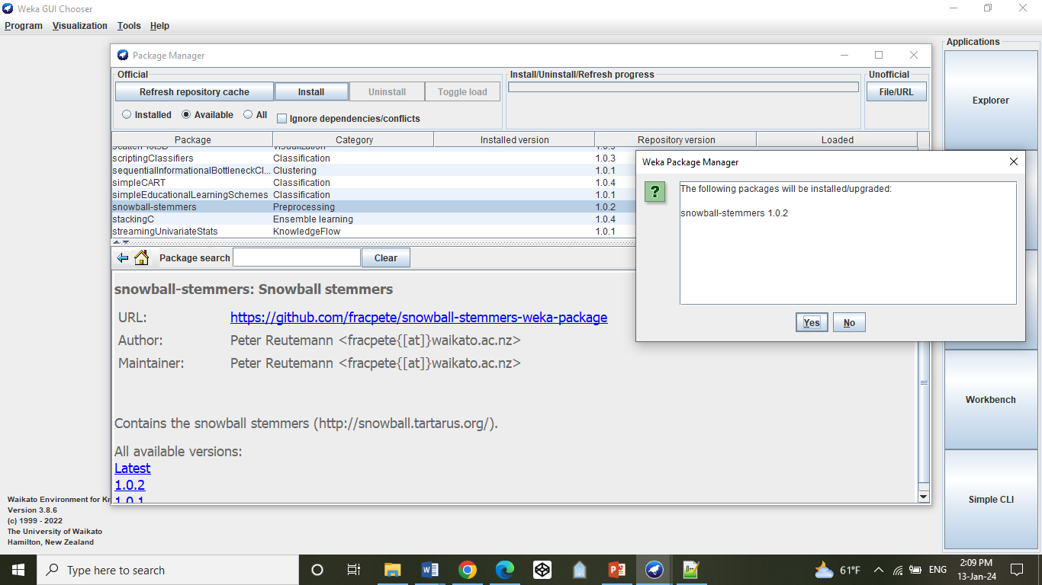

Slide 25
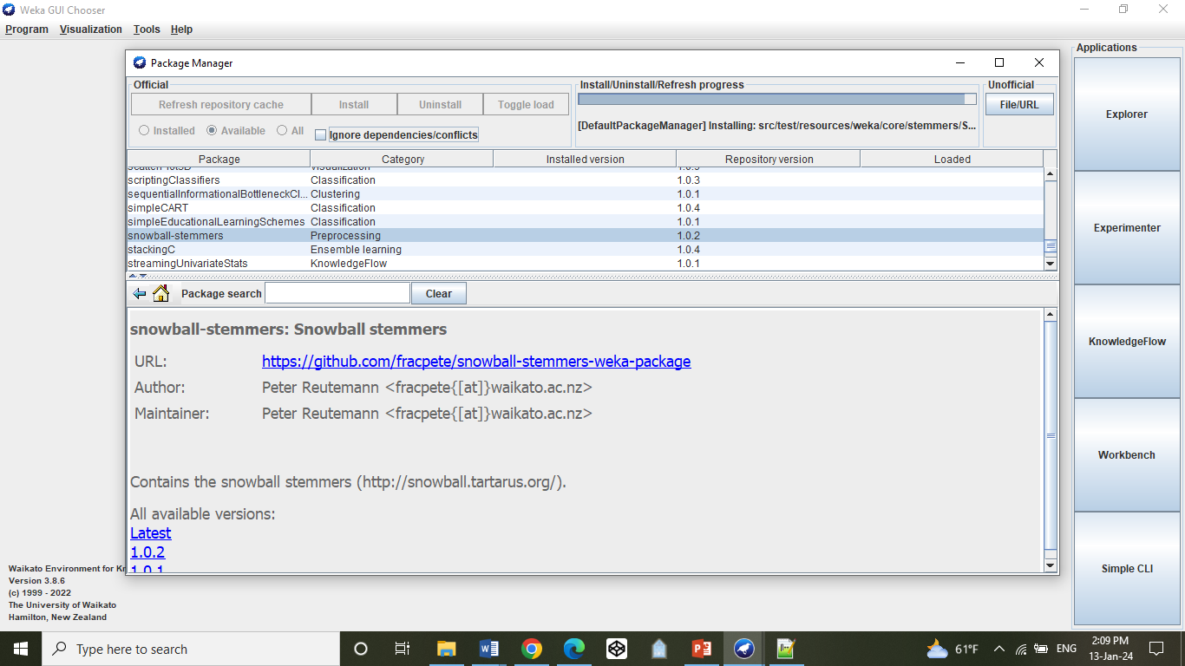

Slide 26
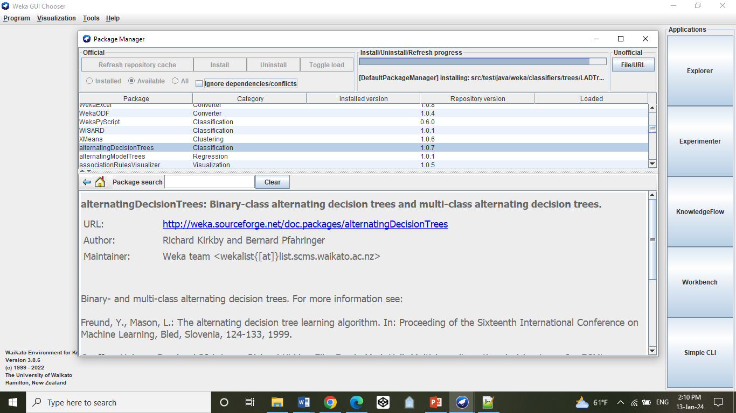

Slide 27
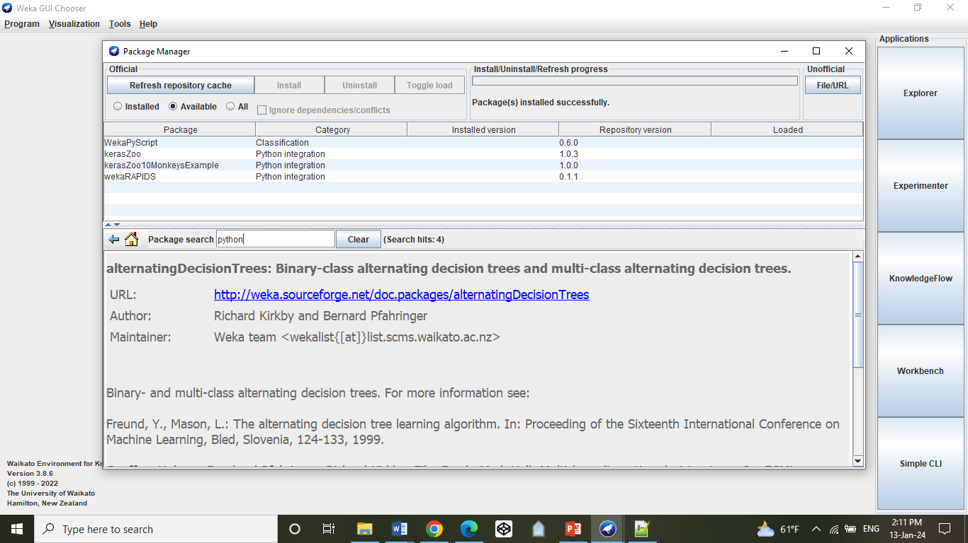

Slide 28
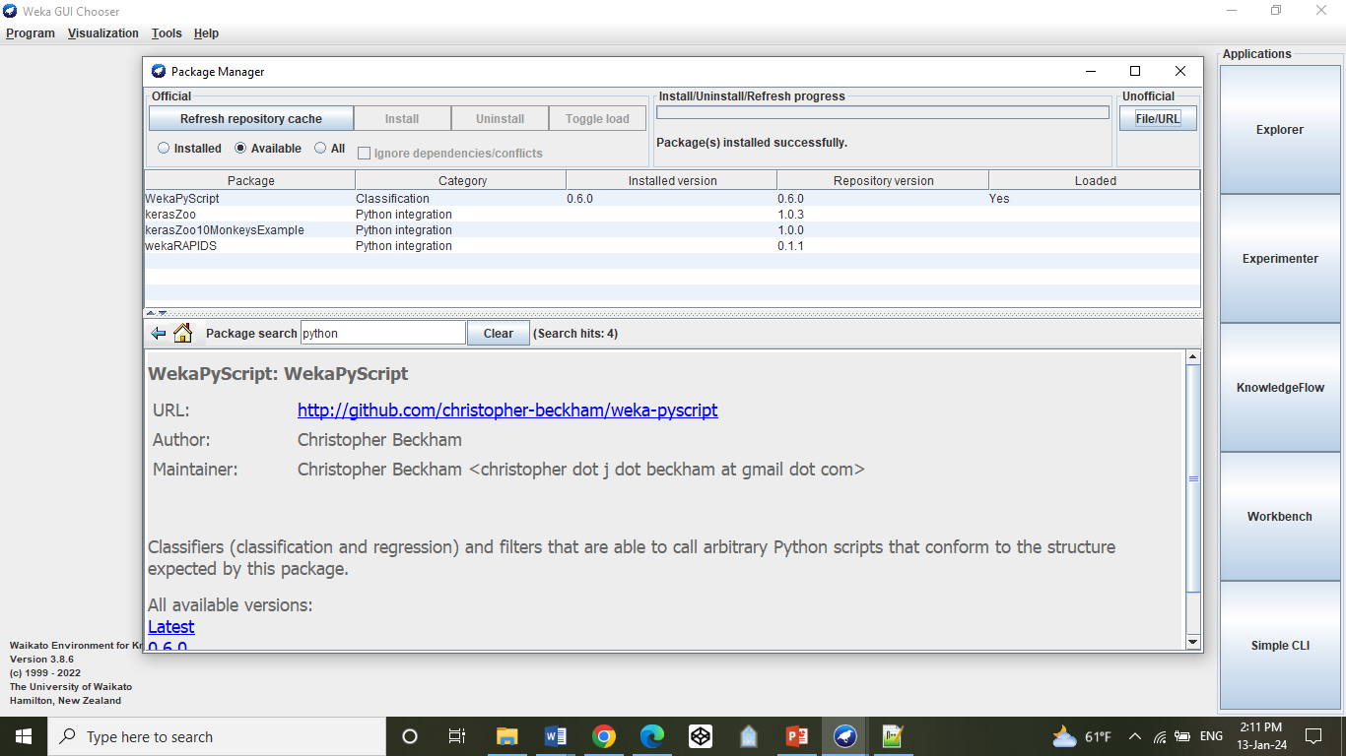

Slide 29
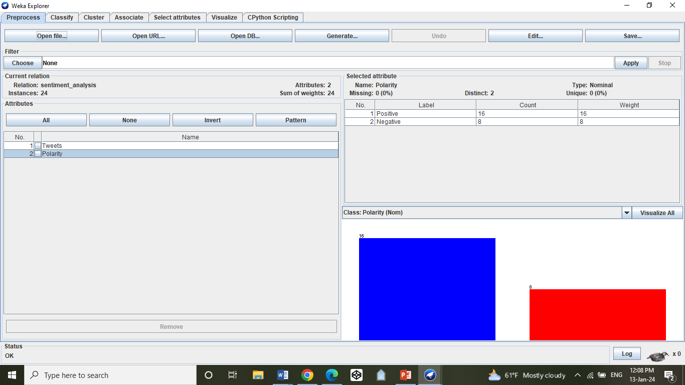

Slide 30
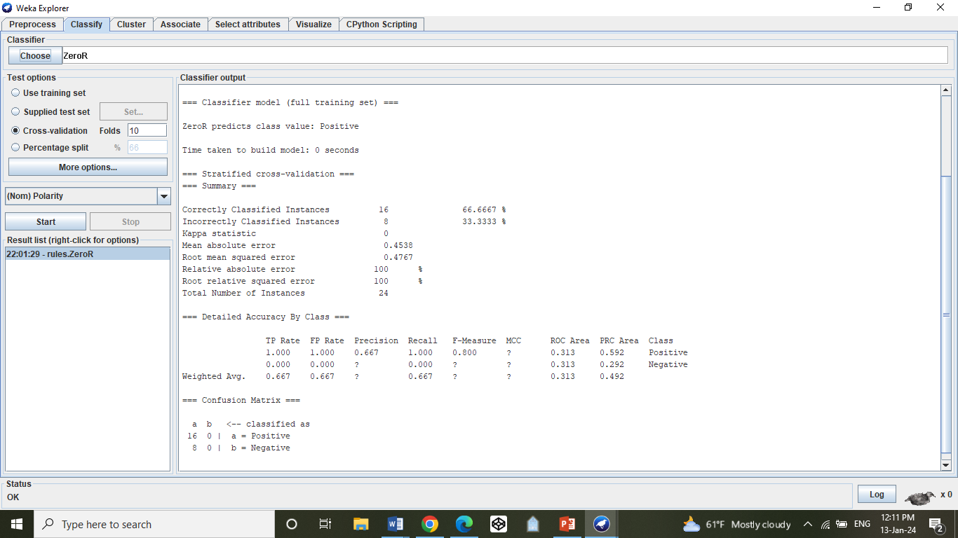

Slide 31
This looks like the result of a sentiment analysis model using a simple rule-based classifier called ZeroR. Let's break down the information:
1. **Classifier Used:** Weka's ZeroR classifier. It's a basic rule-based model that predicts the majority class in the dataset.
2. **Dataset:** The dataset is about sentiment analysis, probably containing tweets. There are 24 instances (data points) with two attributes: "Tweets" and "Polarity."
3. **Prediction:** The ZeroR model predicts the class value "Positive" for all instances. This means it's saying every tweet in the dataset is positive.
4. **Performance Metrics:**
- **Accuracy:** 66.67% of the instances are correctly classified, while 33.33% are incorrectly classified.
- **Kappa statistic:** 0, which indicates poor agreement between predictions and actual values.
- **Mean absolute error:** 0.4538, representing the average absolute difference between predicted and actual values.
- **Root mean squared error:** 0.4767, a measure of the average magnitude of the errors.

Slide 32
5. **Detailed Accuracy By Class:**
- For the class "Positive," the True Positive Rate (TP Rate) is 1.000 (100%), and the False Positive Rate (FP Rate) is also 1.000. Precision is 0.667, Recall is 1.000, and F-Measure is 0.800.
- For the class "Negative," TP Rate is 0.000, FP Rate is 0.000, and other metrics are marked with "?" because there are no instances predicted as "Negative."
6. **Confusion Matrix:** This table shows the number of instances that were correctly or incorrectly classified. In this case, all instances are predicted as "Positive," and none as "Negative."
In summary, the ZeroR model is very basic, predicting everything as "Positive." While it achieves a certain level of accuracy, it's not a reliable model for sentiment analysis, as it doesn't consider the actual content of the tweets and lacks balance in predicting different classes.

Slide 33
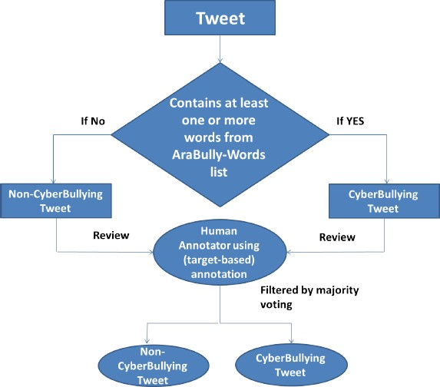

Slide 34
TABLE 2
SAMPLE OF ARABIC BULLYING WORDS
The annotation process (as shown in figure 2) is used with the aid of Python to annotate the dataset for AraBully-Words. The Python code compares every tweet with the list of Ara-Bully-Words; if the tweet has one or more Ara-Bully Words
“Words” | “English Translation”
”ﻏﺑﻲ“ | “Stupid”
" أﺣﻣﻖ " | “Foolish”
" ﻣﺗﻧﻣر" | “Bully”

Slide 35
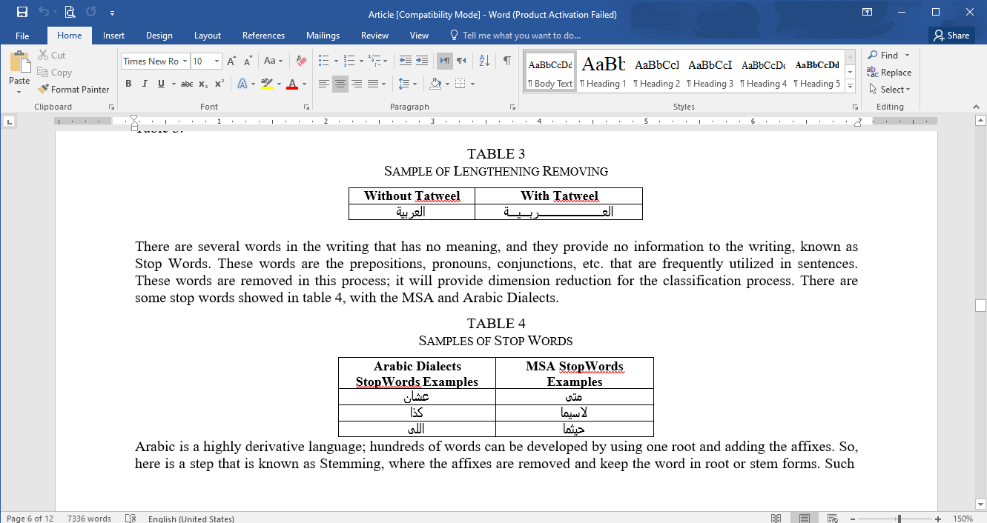

Slide 36
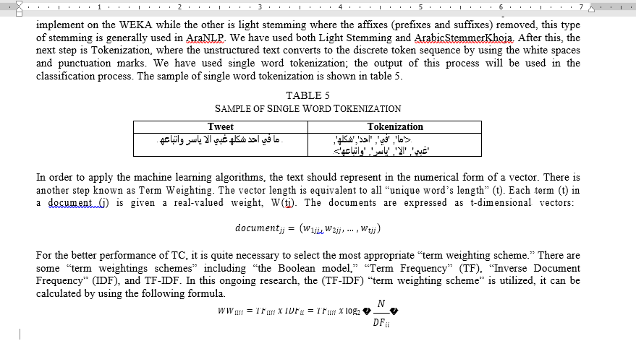

Slide 37
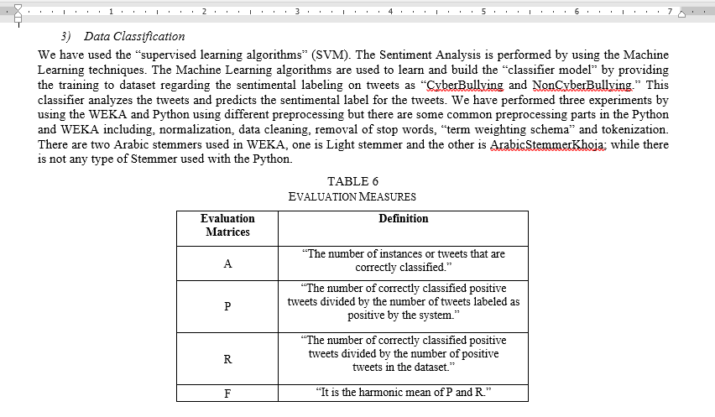

Slide 38
Model Evaluation
There is a way to measure the model performance of a test data based on the mixed number of incorrect and correct predictions, known as the Confusion Matrix. In the confusion matrix, two categories are made for the classification, namely Predicted Class and Actual Class, as shown in Table 6. Conclusively, this confusion matrix is used as the Evaluation Model for our research; in order to get the outcome of performance measures, there are several evaluation measures used like A, P, R, and F, as shown in Table 7. In the “matrix, the TP shows the number of those tweets that are assigned correctly to the belong category while the FN shows the number of not correctly assigned. In addition, the FP shows the number of those tweets that are assigned incorrectly to the given category, and TN shows the number of not correctly” assigned.

Slide 39
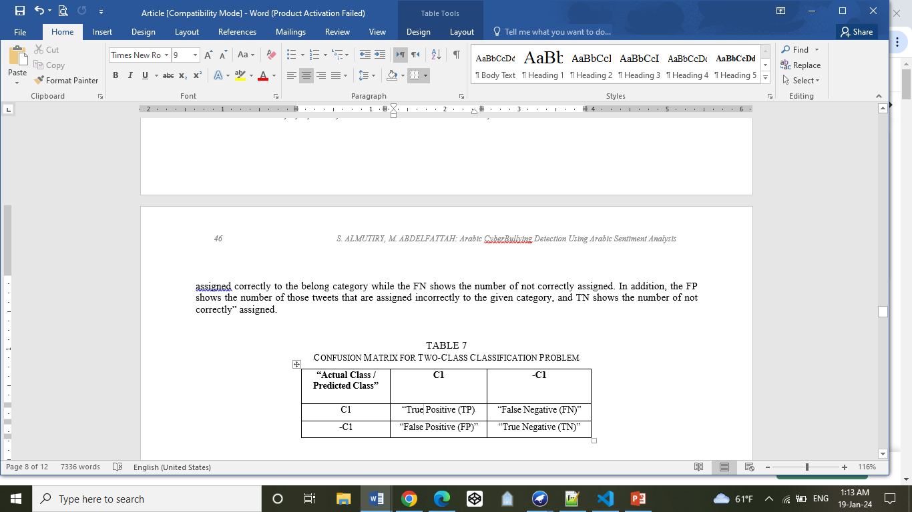

Slide 40
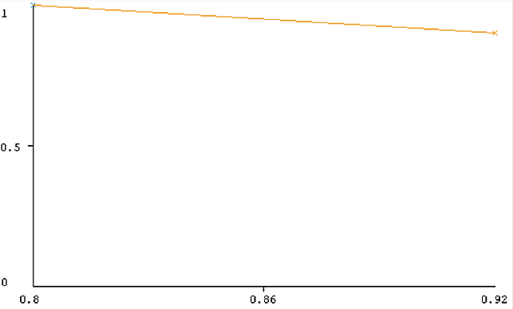
RESULTS
As earlier mentioned, the WEKA and Python are used for this experimentation; in the WEKA we used with Light Stemming and ArabicStemmerKhoja, SVM is used as the classifier in both of them. The encoding of “RunWeka.ini” was changed from the “Cp1252” to the “UTF-8” in order to make the Arabic characters visible in WEKA Explore. To handle the large size of data, the heap size is increased in “RunWeka.ini.” First of all, the experiment is performed by using the WEKA with Light Stemmer and found there are 1525.63 tweets are correctly classified out of 17748, about 85.49%, while the P factor is 0.866, R is 0.859, and the F is 0.862, as shown in Table 8. The Threshold Curve is also generated by using the values of P (x-axis) and R (y-axis) factors to visualize the results, shown in figure 3. The time required to build this classification model is 352.51 seconds.
TABLE 8
RESULTS OF CLASSIFICATION BY USING WEKA WITH LIGHT STEMMER
Total Tweets | A | P | R | F
7748 | 15252.6312 | 0.866 | 0.859 | 0.862

Slide 41
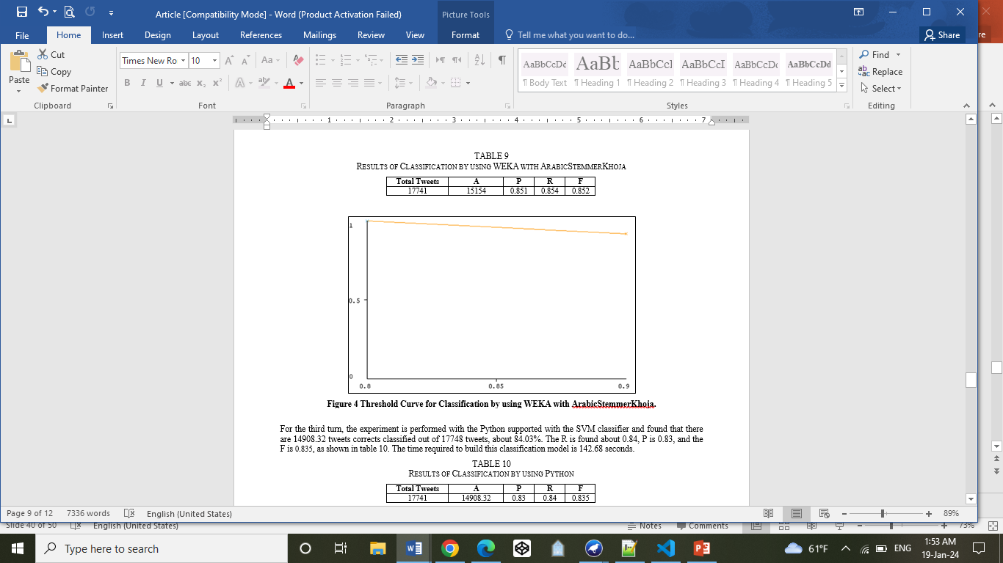

Slide 42
Discussion: Detecting CyberBullying in Arabic Tweets Using Sentiment Analysis
A. Challenges and Language Complexity:
1. Morphological Challenges:
- Arabic's complex morphology, including affixes and clitics, posed challenges in stemming and root word extraction.
- Diacritics and synonyms in Arabic words added intricacy to sentiment analysis.
2. Research Gap:
- Limited research on sentiment analysis, particularly for CyberBullying detection, in the Arabic language.
- Overcoming challenges in a less-explored linguistic context required innovative approaches.

Slide 43
B. Model Evaluation and Comparison:
1. Annotation Method:
- Hybrid annotation involving both automatic tools and native Arabic human checks demonstrated effective CyberBullying detection.
2. WEKA Experiments:
- WEKA experiments with Light Stemmer and ArabicStemmerKhoja showcased comparable accuracy (85.49% and 85.38%, respectively).
- Precision, recall, and F1 score indicated well-balanced model performance in both experiments.
3. Python Experiment:
- Python implementation showed slightly lower accuracy (84.03%) but offered competitive results with faster model building time (142.68 seconds).

Slide 44
C. Comparative Analysis:
1. Performance Metrics:
- WEKA demonstrated higher accuracy in CyberBullying detection compared to Python.
- Precision, recall, and F1 score provided a comprehensive understanding of model effectiveness.
2. Time Efficiency:
- Python exhibited faster model building time (142.68 seconds) compared to both WEKA experiments.
- Trade-off between accuracy and efficiency observed, highlighting the importance of considering computational resources.

Slide 45
D. Implications and Insights:
1. Language-Specific Approaches:
- Addressing language-specific challenges in Arabic requires tailored approaches in preprocessing and feature extraction.
2. Research Contribution:
- Bridging the research gap in Arabic sentiment analysis, particularly in CyberBullying detection, contributes to understanding and addressing online threats.
3. Tool Suitability:
- While WEKA demonstrated superior accuracy, Python's faster processing time may be advantageous in resource-constrained environments.

Slide 46
E. Future Directions:
1. Deep Learning Approaches:
- Exploring deep learning models may offer enhanced performance in handling the complexity of Arabic language structures.
2. Dataset Expansion:
- Expanding the dataset with diverse Arabic dialects and more Cyber Bullying instances can improve model robustness.
3. Cross-Linguistic Analysis:
- Comparative analysis with other languages can provide insights into language-specific challenges and model generalizability.

Slide 47
F. Final Reflection:
In this research, a comprehensive approach to CyberBullying detection in Arabic tweets was undertaken. The study not only addressed language-specific challenges but also contributed to the limited body of research in Arabic sentiment analysis. The findings underscore the importance of considering both accuracy and efficiency in selecting tools for sentiment analysis, with implications for real-world applications and future research endeavors. The integration of advanced techniques, coupled with expanded datasets, promises further advancements in understanding and combating CyberBullying in the Arabic online sphere.

Slide 48
There are various models and algorithms that can be used for sentiment analysis and text classification, including Cyberbullying detection. Here are some popular ones:
1. Naive Bayes:
- Simple and efficient probabilistic model based on Bayes' theorem.
- Particularly useful for text classification tasks.
2. Decision Trees:
- Tree-like model that makes decisions based on the features of the data.
- Easy to interpret and visualize.

Slide 49
3. Random Forest:
- Ensemble learning method that constructs multiple decision trees and merges their outputs.
- Often more accurate than individual decision trees.
4. K-Nearest Neighbors (KNN):
- Instance-based learning algorithm that classifies objects based on the majority class of their k nearest neighbors.
- Particularly effective for smaller datasets.

Slide 50
5. Logistic Regression:
- Statistical model used for binary classification.
- Well-suited for problems where the relationship between features and the target variable is linear.
6. Gradient Boosting:
- Ensemble technique that builds a series of weak learners (typically decision trees) and combines their predictions.
- Can achieve high accuracy but requires more computational resources.

Slide 51
5. Logistic Regression:
- Statistical model used for binary classification.
- Well-suited for problems where the relationship between features and the target variable is linear.
6. Gradient Boosting:
- Ensemble technique that builds a series of weak learners (typically decision trees) and combines their predictions.
- Can achieve high accuracy but requires more computational resources.

Slide 52
9. Support Vector Machines (SVM):
- Effective for text classification tasks, including sentiment analysis.
- Particularly useful when dealing with high-dimensional data.
10. FastText:
- Library for text representation and classification developed by Facebook.
- Efficient for training on large datasets.
The choice of the model depends on various factors, including the size and nature of the dataset, computational resources available, and the specific requirements of the task. It's common to experiment with multiple models and choose the one that performs best for a particular use case. Additionally, deep learning models like BERT and LSTM tend to excel in capturing intricate patterns and dependencies in textual data.

Slide 53
والحمد لله ربّ العالمين

